Slide 1
Predicting Data Breaches with Machine Learning: A Focus on Data Type and Vulnerabilities
Yuta Sugiyama
Revision 2023.11.14
CDS-492 | Fall 2023 | Dr. Slamani

Slide 2
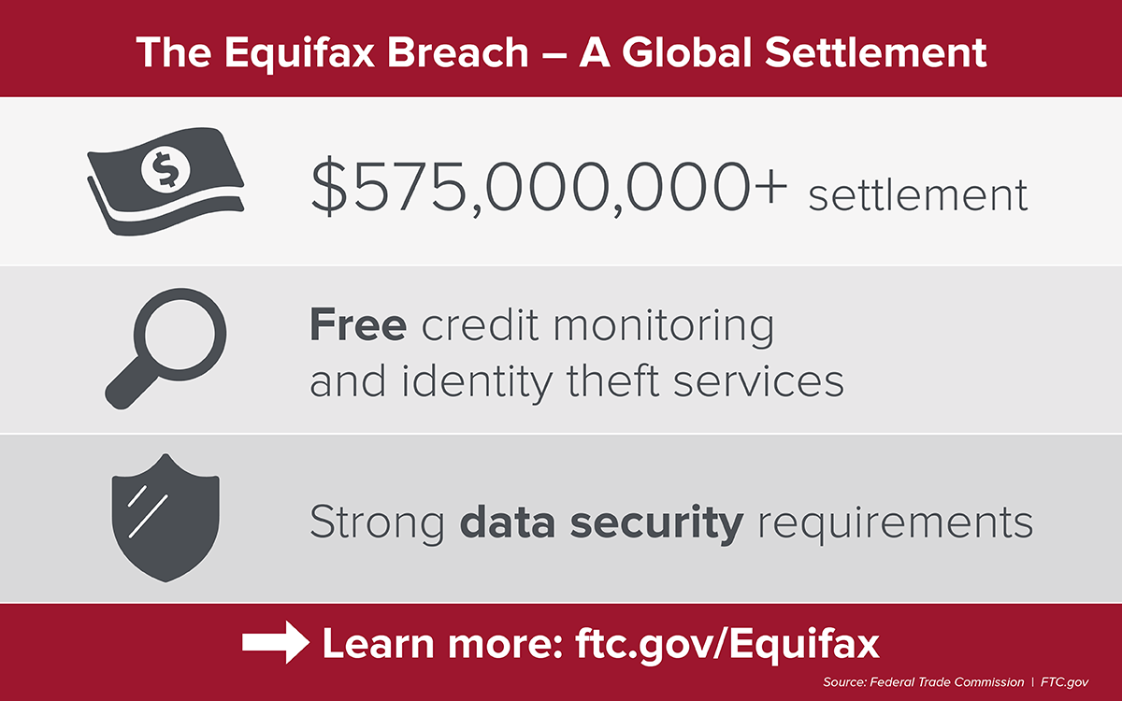
Introduction
Problem description
In the realm of our current efforts in cybersecurity, data breaches have become a common threat, with their frequency and impact on the rise. These breaches happen when unauthorized individuals access private information, causing financial losses, damage to reputations, and legal issues for the people and organizations involved.
Real-world Example
The motivation is exemplified by the 2017 Equifax data breach, compromising sensitive information of 148 million Americans, leading to substantial financial losses, identity theft concerns, and severe damage to Equifax's reputation.

Slide 3
Introduction
Research Questions
Are certain types of organizations more prone to data breaches than others?
How effective are strategies like Data Encryption and Credit Monitoring in preventing or reducing the impact of data breaches?
Can the predictions from our research reveal patterns and motivations behind organized data breaches, offering insights into their targets?

Slide 4
Introduction
Objectives
To analyze and evaluate the vulnerability of different types of organizations to data breaches, considering factors that make them more susceptible.
To assess the effectiveness of data protection strategies, particularly focusing on Data Encryption and Credit Monitoring.
To gain a comprehensive understanding of the patterns and motivations behind organized data breaches, providing valuable insights into their targets and how they are executed.

Slide 5




Benefits of this Study
Localized Risk Assessment
Targeted Resource Allocation
Stakeholders can identify regions that are at a higher risk of data breaches.
Cybersecurity personnel, tools, and budgets can be allocated more efficiently.
Improving Regulations and Policies
Targeted Security Measures
Policy makers can develop and enhance regulations and policies, addressing vulnerabilities.
Understanding organizations and data types with higher risks, can help implement security.

Slide 6
Review of Previous Work (need help here)
01
02
03
04
Model
Model
Model
Model
text
text
text
text

Slide 7
Methods
Data description
Source
State of Massachusetts Office of Consumer Affairs and Business Regulation.
Period
2007 to 2023
File
Size
1.5MB
Rows
22,994
Columns
13
The Original PDF reports transformed into a consolidated .csv file (2007-2022). Isolation of the 2023 dataset to compare with the predictive model.

Slide 8
Methods
Data Columns
Column | Assigned Breach Number 1 | Date Reported 2 | Organization Name 3 | Breach Type Description 4 | Breach Occurrence at Reporting Entity? 5 | MA Residents Affected 6 | SSN Breached? 7 | Account Number Breached? 8 | Driver’s Licenses Breached? 9 | Credit Debit Numbers Breached? 10 | Provided Credit Monitoring 11 | Data Encrypted 12 | Mobile Device Lost Stolen 13
Data Type | Numerical | Date | Categorical | Categorical | Boolean | Numerical | Boolean | Boolean | Boolean | Boolean | Boolean | Boolean | Boolean
Description | A unique identifier for each data breach incident. | The date when the data breach occurred. | The name of the business or organization affected by the data breach. | The format in which the data was compromised, such as "Electronic" or "Paper.” | Whether the breach occurred at the reporting entity. | How many Massachusetts residents were affected by this breach | Whether Social Security Numbers (SSNs) were compromi-sed, with values like "Yes" or empty cells. | Whether account numbers were compromi-sed. | Whether driver’s license numbers were compromi-sed. | Whether credit/debit card numbers were compromi-sed. | Whether the organization offers credit monitoring to individuals/ consumers. | Whether data was encrypted or not for that organizati-on. | Whether mobile device was lost or stolen.

Slide 9
Computational Techniques
Natural Language Processing
Normalization and Denormalization
GridSearchCV
01
03
05
Employed for Organization Categorization
Utilized for hyperparameter tuning to find the best hyperparameters
Scales the features of the data, then conveyed result in the original dataset’s units.
Decision Tree Classifier
Outlier Detection and Handling
RandomUnderSampler
02
04
06
Detection was performed using the IQR method and those outliers were removed
Helps understand how features are utilized to make predictions.
Employed to address class imbalance, by randomly removing instances from the majority class.

Slide 10
Methods
Validation method
GridSearchCV
A technique for hyperparameter tuning that involves defining a grid of hyperparameter values and searching through the grid to find the combination that yields the best model performance.
Cross-validation
Divides the training dataset into subsets (folds). The model is trained and evaluated on different combinations of hyperparameters for each fold, and the average performance is calculated.

Slide 11
Results
Training Accuracy | 0.57
Testing Accuracy | 0.64
 | Precision | Recall | F1-Score | Support
Finance | 0.67 | 0.72 | 0.69 | 2462
Healthcare | 0.52 | 0.28 | 0.36 | 2462
Other | 0.51 | 0.71 | 0.59 | 2462
accuracy |  |  | 0.57 | 7386
macro avg | 0.57 | 0.57 | 0.55 | 7386
weighted avg | 0.57 | 0.57 | 0.55 | 7386
 | Precision | Recall | F1-Score | Support
Finance | 0.80 | 0.70 | 0.75 | 2737
Healthcare | 0.27 | 0.28 | 0.27 | 800
Other | 0.61 | 0.70 | 0.65 | 2053
accuracy |  |  | 0.64 | 5590
macro avg | 0.56 | 0.56 | 0.56 | 5590
weighted avg | 0.65 | 0.64 | 0.64 | 5590

Slide 12
Conclusion
Model Performance
Challenges in NLP
Data Protection Strategies
Future Directions
Demonstrated strong performance in identifying finance organizations, but low precision and recall for Healthcare and Other organization classes.
Manually categorizing organizations by their names due to a high number of unique keywords and budget constraints from the use of Google's API for automation.
There is significance of protecting credit and debit card information and providing credit monitoring security measurers.
More practical approaches to categorizing organizations using NLP.
Recommendations include downsizing the project for specific financial institutions.

Slide 13
Works Cited
Commonwealth of Massachusetts, “Data breach reports,” Mass.gov.
Commonwealth of Massachusetts, 2023. Available: https://www.mass.gov/lists/data-breach-reports
E. P. I. Center, “Equifax Data breach,” Electronic Privacy Information Center (EPIC), 2023. Available:
https://archive.epic.org/privacy/data-breach/equifax/.

